Slide 1

Asp.net
LẬP TRÌNH THEO MÔ HÌNH PHÂN LỚP
Thực hành 1 – ASP.NET CƠ BẢN
Notes:
NOTE:
To change the image on this slide, select the picture and delete it. Then click the Pictures icon in the placeholder to insert your own image.

Slide 2
KHÁI QUÁT ASP
ASP stands for Active Server Pages
ASP is a development framework for building web pages.
ASP supports many different development models:
Classic ASP
ASP.NET Web Forms
ASP.NET MVC
ASP.NET Web Pages
ASP.NET API
ASP.NET Core

Slide 3
Classic ASP - Active Server Pages
ASP (aka Classic ASP) was introduced in 1998 as Microsoft's first server side scripting language.
Classic ASP pages have the file extension .asp and are normally written in VBScript.

Slide 4
ASP.NET
ASP.NET was released in 2002 as a successor to Classic ASP.
ASP.NET pages have the extension .aspx and are normally written in C# (C sharp).
ASP.NET 4.6 is the latest official version of ASP.NET.
ASP.NET 5 was expected to be an important redesign of ASP.NET.
However, the development of ASP.NET 5 was stopped in favor of ASP.NET Core.

Slide 5
ASP.NET MVC
ASP.NET MVC is an MVC application model (Model-View-Controller).
ASP.NET MVC is being merged into the new ASP.NET Core.
ASP.NET MVC is not covered in this tutorial.

Slide 6
ASP.NET Web API
ASP.NET API is an API application model (Application Programming Interface).
ASP.NET API is being merged into the new ASP.NET Core.
ASP.NET Web Forms
ASP.NET Web Forms is an event driven application model.
ASP.NET Web Forms is not a part of the new ASP.NET Core.
ASP.NET Core
ASP.NET Core was released in 2016.
ASP.NET Core merges ASP.NET MVC, ASP.NET Web API, and ASP.NET Web Pages into one application framework.

Slide 7
ASP.NET Web Pages
Web Pages is one of many programming models for creating ASP.NET web sites and web applications.
Web Pages provides an easy way to combine HTML, CSS, and server code:
Easy to learn, understand, and use
Uses an SPA application model (Single Page Application)
Similar to PHP and Classic ASP
VB (Visual Basic) or C# (C sharp) scripting languages

Slide 8
WebMatrix
WebMatrix contains:
Web Pages examples and templates
A web server language (Razor markup with VB or C# code)
A web server (IIS Express)
A database server (SQL Server Compact)
A full web development framework (ASP.NET)

Slide 9
ASP.NET Web Pages - Adding Razor Code
Razor Syntax for C#
C# code blocks are enclosed in @{ ... }
Inline expressions (variables or functions) start with @
Code statements end with semicolon
Variables are declared with the var keyword
Strings are enclosed with quotation marks
C# code is case sensitive
C# files have the extension .cshtml

Slide 10
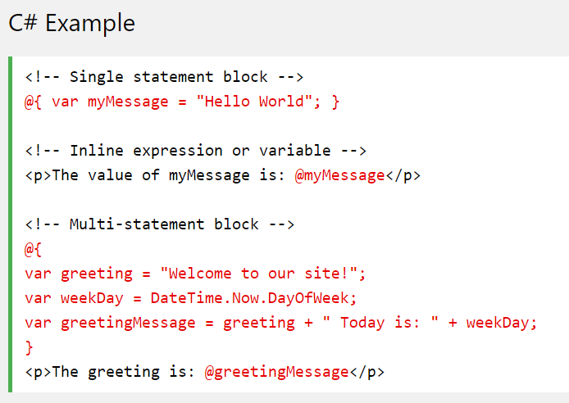

Slide 11
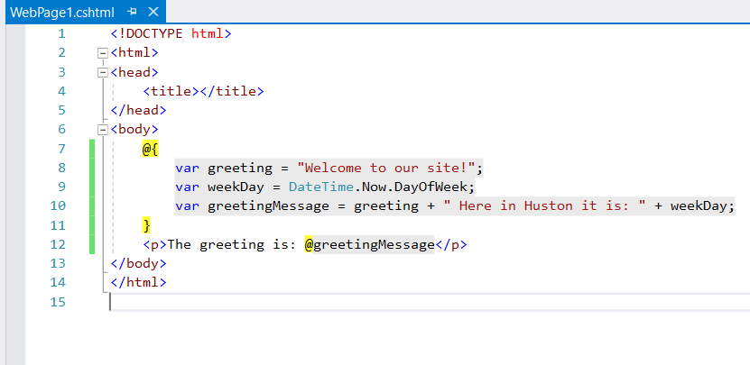
Demo
Visual studio 2017
Tạo project Web application
Tạo mới trang: Click phải project, chọn Add > New Item > Razor > Web page (Razor)

Slide 12
ASP.NET Razor - C# Variables
Data Types
Type | Description | Examples
int | Integer (whole numbers) | 103, 12, 5168
float | Floating-point number | 3.14, 3.4e38
decimal | Decimal number (higher precision) | 1037.196543
bool | Boolean | true, false
string | String | "Hello W3Schools", "John"

Slide 13
Converting Data Types
Method | Description | Example
AsInt() IsInt() | Converts a string to an integer. | if (myString.IsInt()) {myInt=myString.AsInt();}
AsFloat() IsFloat() | Converts a string to a floating-point number. | if (myString.IsFloat()) {myFloat=myString.AsFloat();}
AsDecimal() IsDecimal() | Converts a string to a decimal number. | if (myString.IsDecimal()) {myDec=myString.AsDecimal();}
AsDateTime() IsDateTime() | Converts a string to an ASP.NET DateTime type. | myString="10/10/2012"; myDate=myString.AsDateTime();
AsBool() IsBool() | Converts a string to a Boolean. | myString="True"; myBool=myString.AsBool();
ToString() | Converts any data type to a string. | myInt=1234; myString=myInt.ToString();

Slide 14
Reading User Input
Input is read by the Request[] function, and posting (input) is tested by the IsPost condition:
@{ var totalMessage = ""; if(IsPost) { var num1 = Request["text1"]; var num2 = Request["text2"]; var total = num1.AsInt() + num2.AsInt(); totalMessage = "Total = " + total; } }

Slide 15
Loops and Arrays
For
@for(var i = 10; i < 21; i++) {<p>Line @i</p>}
For Each Loops: If you work with a collection or an array, you often use a for each loop
@foreach (var x in Request.ServerVariables) {<li>@x</li>}
While Loops
@{ var i = 0; while (i < 5) { i += 1; <p>Line @i</p> } }

Slide 16
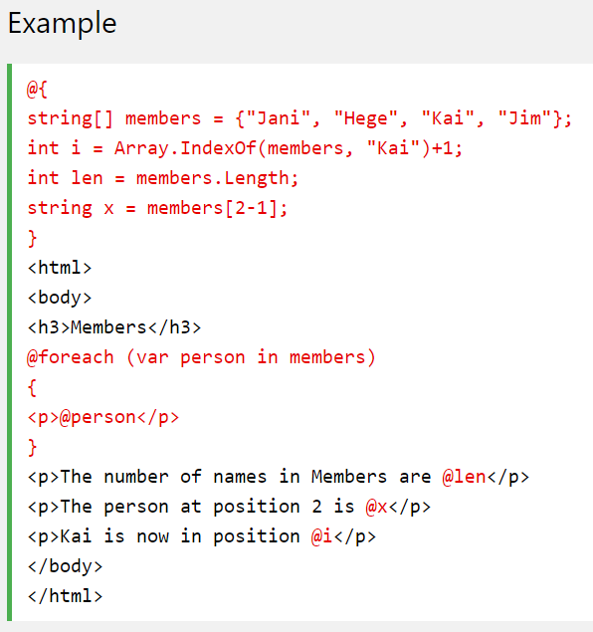
Arrays

Slide 17
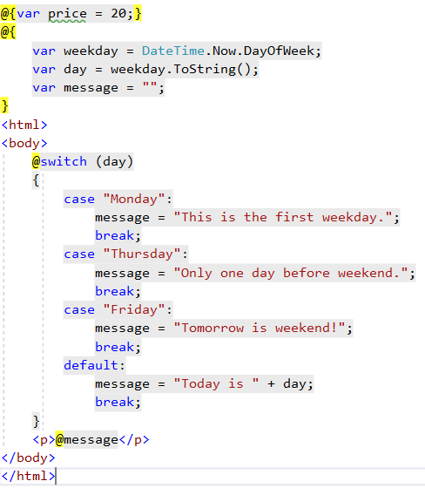
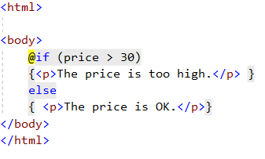
Logic Conditions

Slide 18
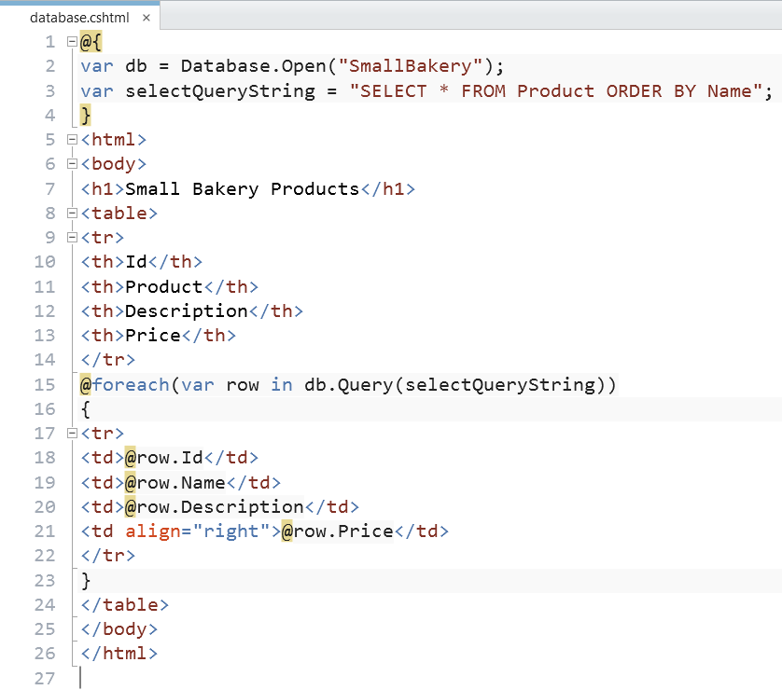
Database
Displaying Data from Database

Slide 19
Database Object Reference
Method | Description
Database.Execute(SQLstatement [, parameters]) | Executes SQLstatement (with optional parameters) such as INSERT, DELETE, or UPDATE and returns a count of affected records.
Database.GetLastInsertId() | Returns the identity column from the most recently inserted row.
Database.Open(filename) Database.Open(connectionStringName) | Opens either the specified database file or the database specified using a named connection string from the Web.config file.
Database.OpenConnectionString(connectionString) | Opens a database using the connection string. (This contrasts with Database.Open, which uses a connection string name.)
Database.Query(SQLstatement[, parameters]) | Queries the database using SQLstatement (optionally passing parameters) and returns the results as a collection.
Database.QuerySingle(SQLstatement [, parameters]) | Executes SQLstatement (with optional parameters) and returns a single record.
Database.QueryValue(SQLstatement [, parameters]) | Executes SQLstatement (with optional parameters) and returns a single value.

Slide 20
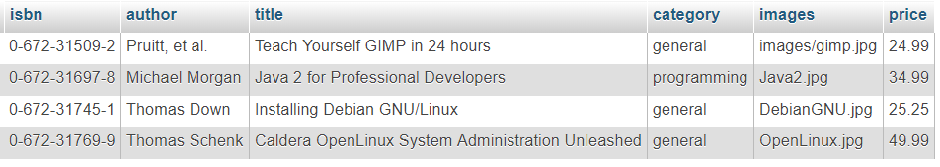
Bài tập (30 phút)
Cài đặt Webmatrix 3
Tạo CSDL SQL Server: bookstore với bảng books như sau:
Tạo trang web displayBook.cshtml hiển thị danh sách các sách

